Slide 1


Team 18: Kubernetes
Based Attacks
Bi-Weekly Update 4 Thomas Gumienny, Patrick Churchill, Albert Ma Sponsor: Sandip Roy TA: Sabyasachi Gupta
Notes:
Michelle

Slide 2
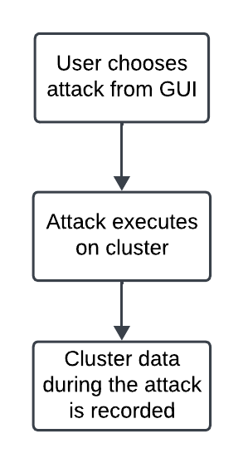
Project Summary
The US Navy is using Kubernetes to manage software. However, as a relatively new cyberservice, Kubernetes has a variety of cybersecurity weaknesses.
Develop a Kubernetes testbed that can simulate and collect the data of common types of attacks, and can also serve as a way to run more attacks
Notes:
Kyle

Slide 3
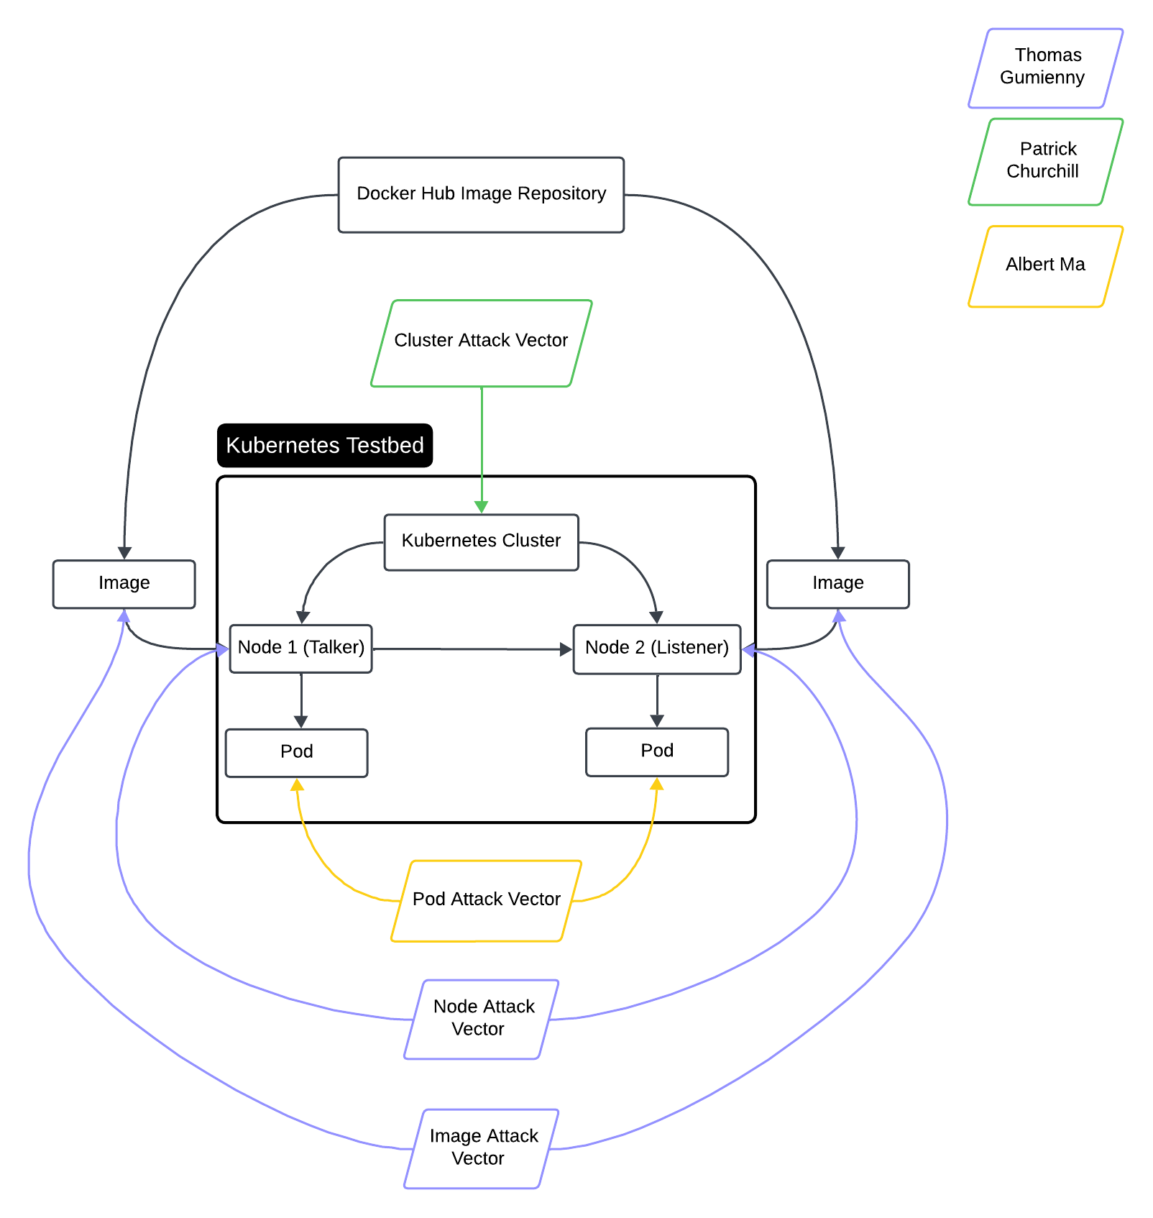
Project/Subsystem Overview
Thomas Gumienny - Image Attack
Image has similar name to normal docker image
When run, image consumes CPU/GPU resources
Albert Ma - Pod Attack
Set up target pod, and conduct reconnaissance on network
Gain access to target pod and container and all stored info
Patrick Churchill - Cluster Attack
Server Node applies pods upon Agent Node that overload the memory and CPU on Server Node, causing it to crash
Notes:
Eric

Slide 4
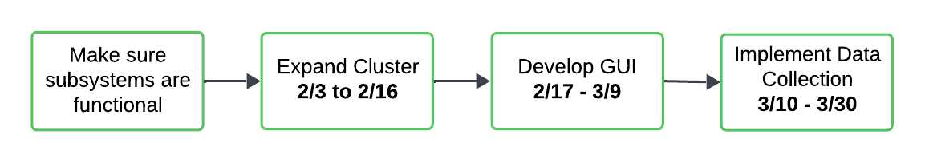
Project Timeline
Notes:
Eric

Slide 5
Image Attack Vector
Thomas Gumienny
Accomplishments since 3/5 19 hrs of effort | Ongoing progress/problems and plans until the next presentation
Image attack no longer freezes GUI Cluster CPU usage display added Netflow capture exports file to Downloads GUI reorganized | Complete guide to setting up cluster from scratch Tweak Image Attack so it runs until stopped

Slide 6

Image Attack Vector
Thomas Gumienny

Slide 7
Netflow Data Export
Thomas Gumienny

Slide 8
Node Attack Vector
Patrick Churchill
Accomplishments since 3/5 18 hrs of effort | Ongoing progress/problems and plans until the next presentation
Successfully ran and deleted attack from GUI Increased number of pods deploy at a lower usage, increasing speed of attack while decreasing visibility | Implement live tracker of pods during attack

Slide 9
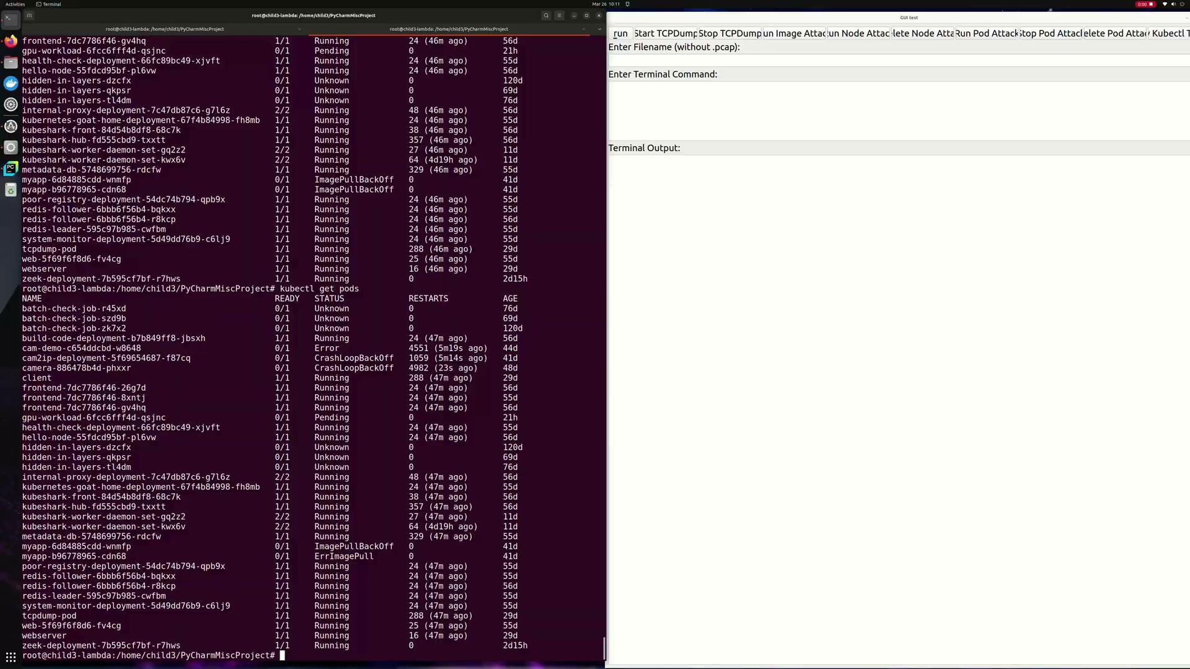
Node Attack Vector
Patrick Churchill

Slide 10
Pod Attack Vector
Albert Ma
Accomplishments since 3/5 20 hrs of effort | Ongoing progress/problems and plans until the next presentation
Updated the bash script to spam pull 100GB containers Consumed at least 8% within 5 minutes Integrated a “kill switch” and delete attack buttons on GUI | Optimize the attack script to make it run faster

Slide 11
Pod Attack Vector
Albert Ma

Slide 12
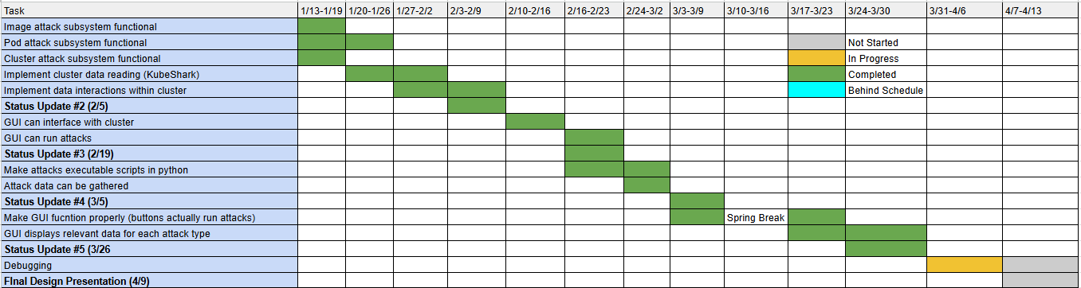
Execution Plan
Notes:
Michelle

Slide 13
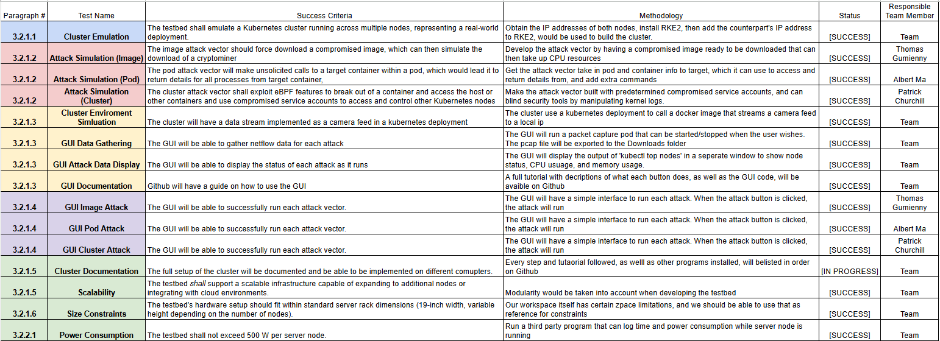
Validation Pan
Notes:
Michelle

Slide 14
Thank You

